Slide 1

Lesson 7: Presentation skills II Effective use of PowerPoint and Self evaluation.
Dr Fadi Safieddine
1
Dr. Fadi Safieddine copyright 2021

Slide 2

Content:
Why use PowerPoint?
Seven tips to create an effective PowerPoint presentation.
Example of a good presentation:
Present a 15 mins presentation on my research

Slide 3
A reminder of the skills:
Voice: Keeping it loud and clear. Not monotonous.
Eye Contact: with the audience/hand and body movement.
Not to read from the slides
Not to read from paper or phone.
Group: Taking Turns in the presentation / Greeting the audience.
Rehearsing / Rehearsing / and rehearsing
Not too much animation
Use graphics to summarise
Dress for the occasion.

Slide 4

Why PowerPoint?
To organize ideas better
To hold interest
To focus attention
To guide discussions/overviews
To tell a story
To support the message being delivered
Notes:
One of the best reasons to use PowerPoint is the ability it gives you to present content in a qualitatively different way through the use of graphics, charts, animation, and even video or audio.
We all learn differently and a presentation using PowerPoint can help those who are Visual as well as Auditory learners

Slide 5


Tip #1 for Oral Presentations
Do not write too much on the slides.
Stick to bullet points.
Notes:
Too much text distracts your audience and can be difficult to read.

Slide 6

Tip #2 Use animation
But do not over do it.
Notes:
The rule of thumb is one method of transition and one type of animation for the whole slideshow.
Do not have some text flying in, some spiraling, etc.
Move from slide to slide with one transition, rather than trying out several.

Slide 7
Tip #3: Stick to one theme.
Be consistent in your choice of bullets, font, and colors.

Slide 8

Fonts and Background Colors
This is a good mix of colors. Readable!
This is a bad mix of colors. Low contrast.
Unreadable!
This is a good mix of
colors. Readable!
This is a bad mix of
colors. Avoid bright
colors on white.
Unreadable!
Notes:
Choose your background based on a room's lighting: While what is most common is to design with a dark background when you plan to project your slideshow onto a screen, in reality, the best background has to do with the presentation location. Although light text on a dark background looks best in a dark or slightly darkened room, in a light room the dark background may look so faded that light text may not show up as well. For this kind of situation, it doesn't hurt to try dark text on a lighter background

Slide 9
Tip #4: Use tables and images
Make sure they are readable.
AVOID

Slide 10

Tip #5: Keep white spaces
Do not overwhelm the page with graphics and content.
Notes:
Too many elements on one slide will simply distract your audience.

Slide 11

Slide Overkill
2. The data suggest that the high-level wells tap interconnected, though
bounded, aquifers whose rate of water level decline is inversely proportional
to its volume. Future well drilling for high-level potable sources must include
accurate, well-designed aquifer tests that will aid in the determination of
geologic boundaries to provide information on the geometry of the aquifer.
3. The data suggest that there may be more than geological mechanism that
created the high-level aquifer.
4. The data suggest that there is a water level pattern observed in the high-level
wells with Keopu being the “drain” for the ground-water flow system. The
ground-water flux south of Keopu is to the north, and north of Keopu, the
ground-water flow is to the south.
5. Some high-level wells do exhibit quasi-stable water levels, and show little
variation over time. Use of long-term water level transducers in these wells
should continue in conjunction with long-term water level transducers in those
wells that show water level decline. Real time correlation between water
levels in the wells with climatic conditions measured at Lanihau Rain Gage
will provide better insight into the behavior of the potable high-level aquifers.
AVOID

Slide 12
Washout Picture
1. Insert a Picture by choosing Insert>Picture>From Device
2. Resize it to completely fill the frame
3. Right Click the picture:
- Select Picture Format
-
4. Under Color, choose Washout

Slide 13
Washout Picture
1. Insert a Picture by choosing Insert>Picture>From Device
2. Resize it to completely fill the frame
3. Right Click the picture:
- Select Picture Format
-
4. Under Color, choose Washout

Slide 14
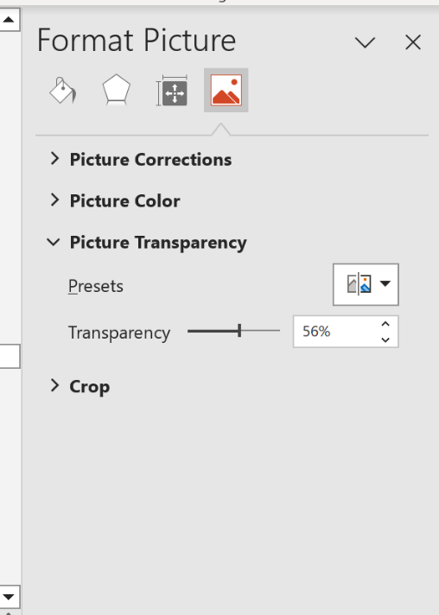
Washout Picture
1. Insert a Picture by choosing Insert>Picture>From Device
2. Resize it to completely fill the frame
3. Right Click the picture:
- Select Picture Format
- Select the Picture Icon
- Change Transparency

Slide 15
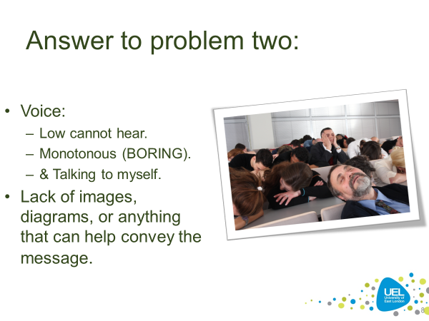
Tip #6: Use Graphics
Do use some graphics in your slideshow.
Nothing is more boring than an all-text slideshow.
Choose them carefully, though.

Slide 16
GIF Examples

Slide 17
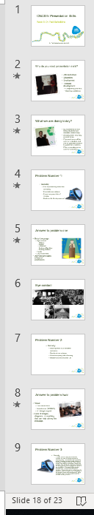
Tip #7: Have a structure
Title [Slide]
Table of Content [Slide]
<<Content>>: lots of slides.
References [Slide]
Q&A [Slide]

Slide 18
End of part 1
Activity 7.1. Organise the following topics in the correct order of a presentation:
Table of Content [Slide]
References [Slide]
Q&A [Slide]
Title [Slide]
<<Content>>: lots of slides.

Slide 19
Pitching IT Proposal
Part 2
Notes:
Rehearse your show several times before presenting it to a live audience. Know when you will move on and have some sense of the time required. Know how to use the computer. Don't be fumbling about trying to figure out how to move from slide to slide.
Avoid standing or sitting right behind your computer when you present. If necessary, have an assistant run the computer while you speak.
PowerPoint slideshows are intended to accompany and illustrate your own verbal presentation
Check equipment: Turn on all equipment and make sure it all works, especially the hand controller. Batteries good?
Equipment: What equipment will be used? Computer? Overhead projector? What are its features? Who is responsible for getting it all to the site and set up?
Software: What software (and its version number!) will run the presentation? Does it match what you used to create it? If not, does it matter?
Media: How will you transport the presentation to the site? Will your presentation fit on the media you plan to use to transport it? Can the computer that will run the presentation use that type of media? (floppy disk, zip disk, USB drive, CD, DVD?)
Handouts: Who is bringing? How to distribute and when and by whom?

Slide 20

Remember the purpose
Remember the objectives of any presentation are:
To inform: Teach people something new?
To Persuade: Change people’s view.
To entertain: Keep people’s attention.
Notes:
Rehearse your show several times before presenting it to a live audience. Know when you will move on and have some sense of the time required. Know how to use the computer. Don't be fumbling about trying to figure out how to move from slide to slide.
Avoid standing or sitting right behind your computer when you present. If necessary, have an assistant run the computer while you speak.
PowerPoint slideshows are intended to accompany and illustrate your own verbal presentation
Check equipment: Turn on all equipment and make sure it all works, especially the hand controller. Batteries good?
Equipment: What equipment will be used? Computer? Overhead projector? What are its features? Who is responsible for getting it all to the site and set up?
Software: What software (and its version number!) will run the presentation? Does it match what you used to create it? If not, does it matter?
Media: How will you transport the presentation to the site? Will your presentation fit on the media you plan to use to transport it? Can the computer that will run the presentation use that type of media? (floppy disk, zip disk, USB drive, CD, DVD?)
Handouts: Who is bringing? How to distribute and when and by whom?

Slide 21
Evaluating a presentation:
Pitching an IT idea
Using the evaluation form you see next, evaluate the 15 mins recorded presentation.
Write what you think worked and what did not work.

Slide 22
Evaluating a presentation:
Criteria: explanation | Allocation | Grade
PowerPoint: The quality and content of the PowerPoint presentation. Presentation Structure Presentation use of bullet points Use (but not overuse) of animation Good use of images and graphics Color theme matches | 10pts
Preparation: Did the group present in a professional manner? Eye contact with audience Variable voice while speaking Rehearsed (not reading from the slides). Transitioning between groups. Explanation of difficult terms. Dressed for the occasion. The presentation content is presented in an interesting way. | 10pts

Slide 23
End of part 2
Activity 7.2. Download the ‘Evaluation for Presentation’ form:
Watch the recording of the video.
Write your comments on the form (you can pose it at times).
Once finished, reflect what you liked and disliked from the presentation.
Copy/paste the results in the activity 7.2.

